Slide 1
Stories of Migration: SLIDE 1
Spidergram

Slide 2
Stories of Migration: SLIDE 2
Example of completed Spidergram

Slide 3
Stories of Migration: SLIDE 3
Migration is not always international.
Migration can also be internal within a country:
- from region to region
- between rural and urban
- between small towns and larger cities
If you have not migrated in your own lifetime, extend your thinking back through the generations to your parents/guardians, or perhaps to grandparents and relatives (aunts, uncles, cousins etc).
If you don’t know all the details, it does not matter.

Slide 4
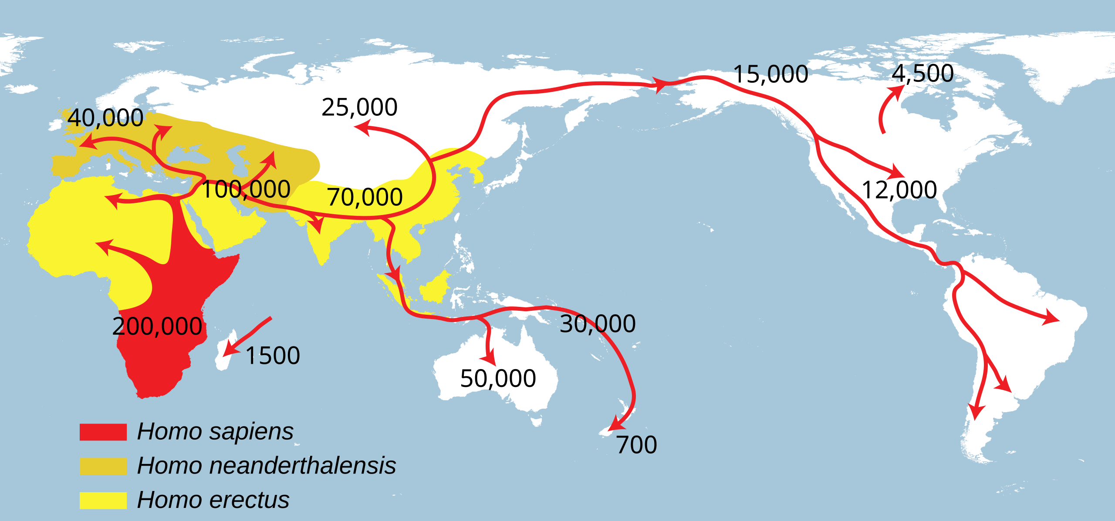
Stories of Migration: SLIDE 4
Human migration in our history (X = years ago)

Slide 5
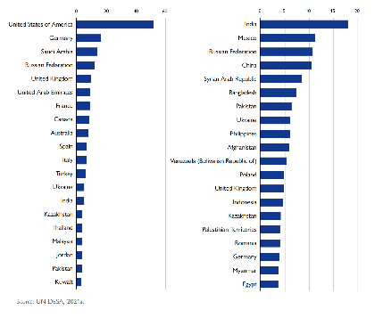
Stories of Migration: SLIDE 5
Top 20 destinations (left) and origins (right) of international migrants in 2020 (millions)

Slide 6
Stories of Migration: SLIDE 6
Language – the words/phrases we use
Food – what we eat and cook with
Music – styles, artists, influences
Things – goods and products
Sports – games, individuals, teams etc
Leisure – TV, past-times, books etc
Media – (including social media) – content, influencers, trends etc

Slide 7

Stories of Migration: SLIDE 7

Slide 8
Stories of Migration: SLIDE 8
“Are you sitting comfortably?
Then this story is not for you”.

Slide 9
Stories of Migration: SLIDE 9
“This is a different kind of migration story to the one you may have seen in the media or heard from the mouths of politicians.”

Slide 10
Stories of Migration: SLIDE 10

Slide 11
Stories of Migration: SLIDE 11

Slide 12
Stories of Migration: SLIDE 12

Slide 13
Stories of Migration: SLIDE 13

Slide 14
Stories of Migration: SLIDE 14

Slide 15
Stories of Migration: SLIDE 15

Slide 16
Stories of Migration: SLIDE 16

Slide 17
Stories of Migration: SLIDE 17

Slide 18
Stories of Migration: SLIDE 18

Slide 19
Stories of Migration: SLIDE 19

Slide 20
Stories of Migration: SLIDE 20

Slide 21
Stories of Migration: SLIDE 21

Slide 22
Stories of Migration: SLIDE 22
“This is a story about the fleers, the flyers, the seekers, the movers, the migrants”.

Slide 23


Stories of Migration: SLIDE 23
PUSH and PULL
a way to understand migration
PUSH – from a place
PULL – to a place

Slide 24
Stories of Migration: SLIDE 24
Defining PUSH and PULL factors
PUSH factors are those which force a person to move. They might include drought, famine, lack of jobs, overpopulation, civil war, personal safety.
PULL factors are those which encourage a person to move. These might include a chance at a better job, better education, a better standard of living, personal safety, freedom.
PUSH and PULL factors can be economic, social, environmental, political and cultural or a combination of these.

Slide 25


Stories of Migration: SLIDE 25
The Boy with More?
Unstoppable Beat

Slide 26

Stories of Migration: SLIDE 26
Chimamanda Ngozi Adichie
The Danger of a Single Story

Slide 27
Stories of Migration: SLIDE 27
Discussing ‘The Danger of a Single Story’
How do Adichie’s ideas build on those they had already shared about why multiple stories might be important?
Why do you think Chimamanda chose to use the word ‘danger’?
What is the danger she is referring to?
How might this ‘danger’ relate to stories of migration?

Slide 28

Stories of Migration: SLIDE 28

