Slide 1
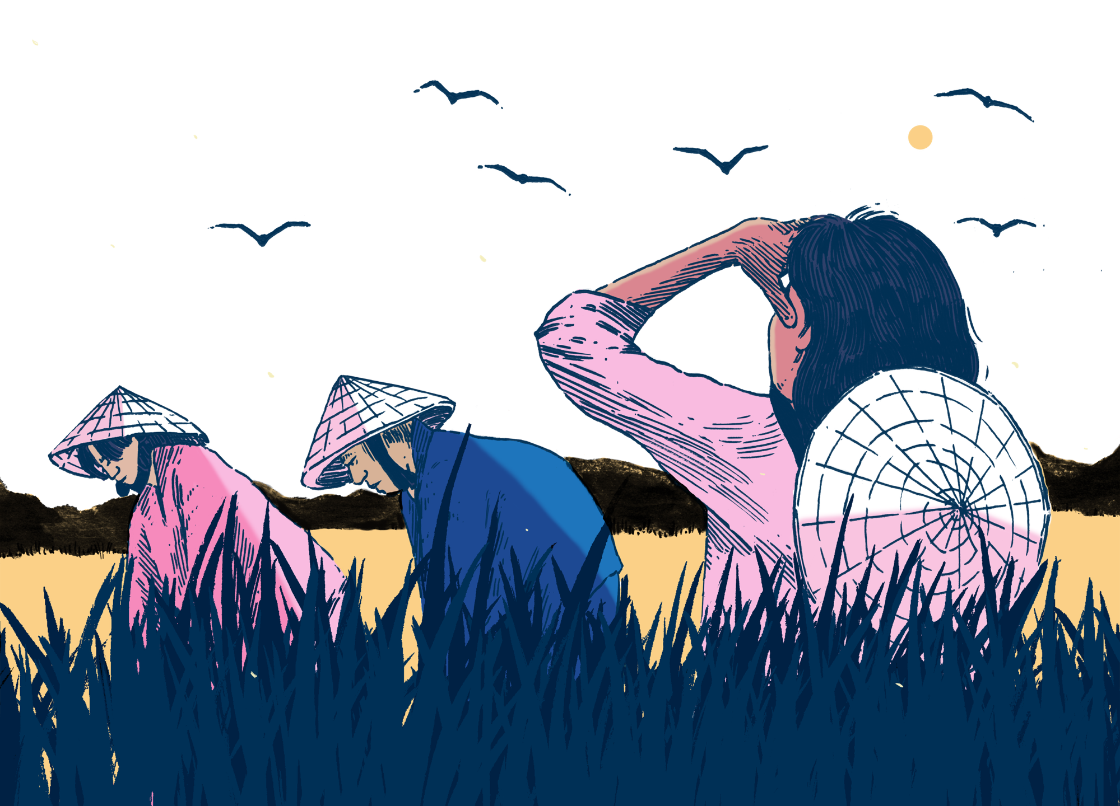



Migration Rhythms
Learning & Engagement

Slide 2
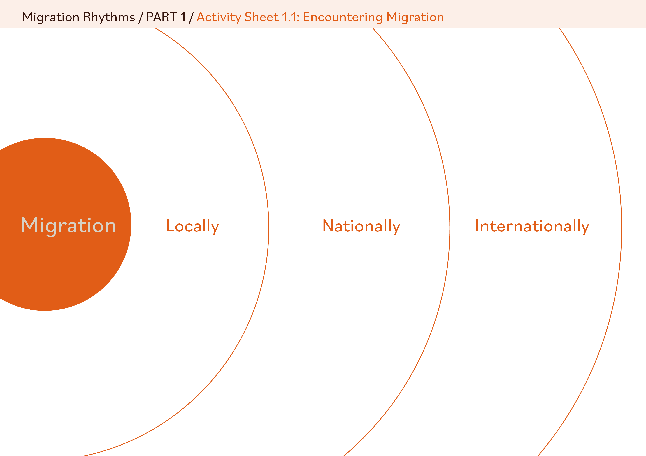
Migration Rhythms – SLIDE 2
How do you encounter migration at these scales?

Slide 3
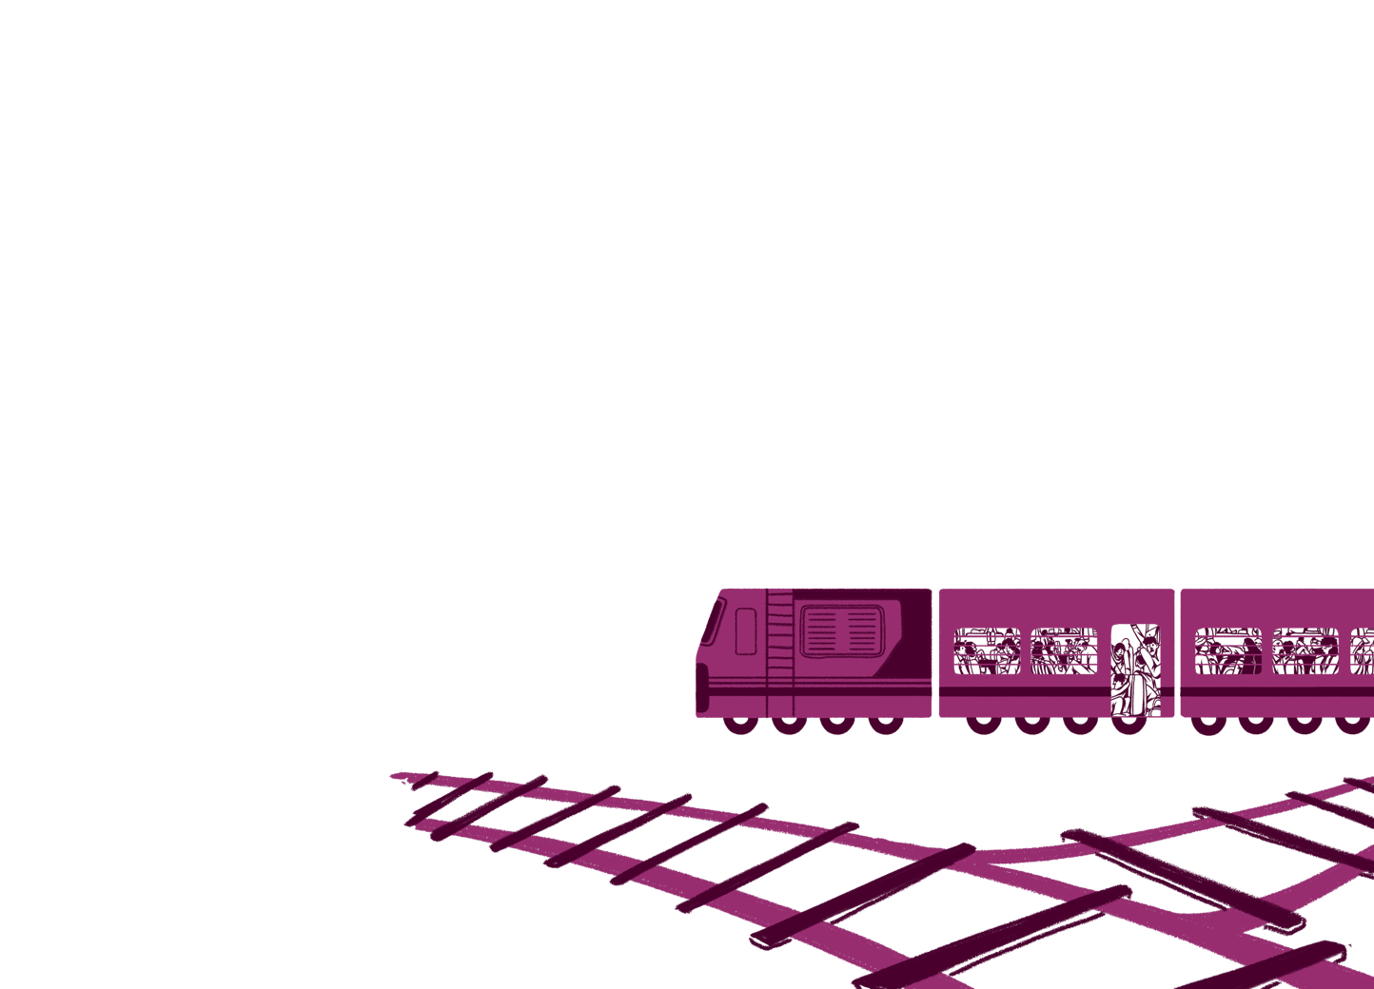
Migration Rhythms – SLIDE 3
How do you encounter migration…?
…in direct relationships and connections
…through social media
…through conversations with friends/family
…in the news and other media
…in popular culture (film, TV, music etc)
…in politics
…in education and learning
…through language and related terms

Slide 4

Migration Rhythms – SLIDE 4
Migration is an umbrella term; there are many different forms of people moving.
Most migration takes place within countries (e.g. rural to urban) rather than between countries.
The reasons people may move are complex and can change over time.
Migration is not always permanent or one way.

Slide 5
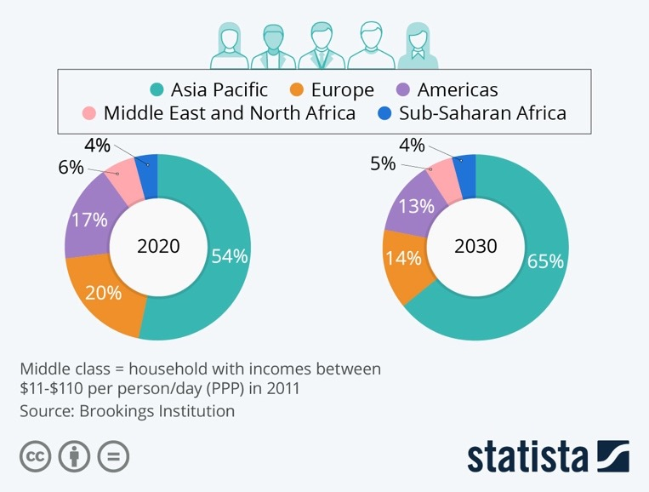
Migration Rhythms – SLIDE 5
Share of the global middle class by major geographical region
PPP means Purchasing Power Parity and is a way of measuring incomes by what can be purchased in US$ equivalent in different countries.

Slide 6
Migration Rhythms – SLIDE 6
Middle class (noun): a social group that consists of well-educated people, such as doctors, lawyers and teachers, who have good jobs and are not poor, but are not very rich. (Cambridge Dictionary, UK definition)
Middle class (noun): a social stratum that is not clearly defined but is positioned between the lower and upper classes. It consists of business people, professional people etc, along with their families, and is marked by bourgeois values. (Collins Dictionary, UK definition)
Middle-classness is a multifaceted concept that reflects a particular position within a social hierarchy, defined by a combination of socioeconomic factors, values, and lifestyles. (Google AI definition)
Defining middle classness

Slide 7
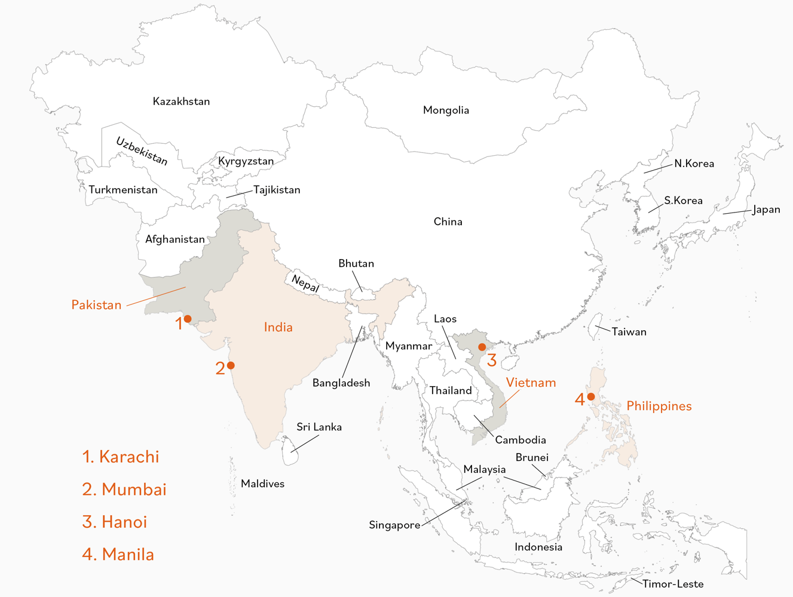
Migration Rhythms – SLIDE 7
Partial map of Asia showing four study countries and cities*
* approximate locations
Map created by Rob Bowden/Lifeworlds Learning
Base Map by FreeVectorMaps.com
(https://freevectormaps.com/world-maps/asia/WRLD-AS-01-0002?ref=atr)

Slide 8

Migration Rhythms – SLIDE 8
What did they find most interesting about their story?
How do stories add meaning and understanding about a place or issue in ways that data and text might not?
How does the artwork help to shape the story and your understanding?
Why might first person perspectives be important in learning about another place or issue?

Slide 9


Migration Rhythms – SLIDE 9
Window: looking at new places, like opening a new window, can reveal new things or allow us to see things (including similar things) from a different perspective.
Mirror: the light (new ideas and perspectives) from looking through new windows on our world can also lead us to reflect on ourselves, our place, and our understanding of the world, in new ways.

Slide 10


Migration Rhythms – SLIDE 10
PUSH and PULL factors as a way of understanding migration
PUSH – from a place
(motivations to leave a particular place or situation)
PULL – to a place
(motivations attracting people to a place or opportunity)

Slide 11
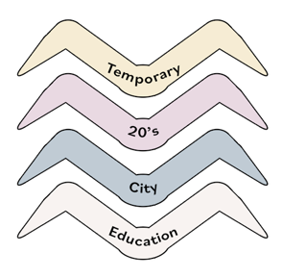
Migration Rhythms – SLIDE 11
Cut out birds are colour-coded to breakdown different aspects of movement pathways: reason, where, life stage, type. Use the birds in any order to construct pathways by writing on them and connecting them to form a pathway. An example is shown right. Ideas are shared below should you need them.
Reasons for movement
Education
Employment
Relationship
Support
Housing
Quality of life
Community
Family
Personal interests
Where movement is to
City
Town
Rural
Neighbourhood
District
Region
Country
Life stage of movement
Teens
20’s
30’s
40’s
50’s
60’s
70’s +
Type of movement
Permanent
Temporary
Daily
Weekly
Seasonal

Slide 12
Migration Rhythms – SLIDE 12
“We’ve taken it for granted that each generation will do much better than the last – earning more and enjoying a higher standard of living. But that approach risks looking complacent given the realities of recent years and prospects for the future.”
(Torsten Bell, Director of the Resolution Foundation in The Guardian, 18th July 2016)
“By age 35, 17% of Baby Boomers* had followed a path in which they progressed from college into prestigious professional careers like law and medicine, whereas only 7.3% of Millennials* did the same.”
(Rob Gruijters, University of Cambridge Boom and bust? Millennials aren’t all worse off than Baby Boomers, but the rich-poor gap is widening)
“Millennials tended to postpone marriage and prolong their stay in the parental home. Early marriage and parenthood characterised the lives of 27% of Boomers, but just 13% of Millennials.”
(Rob Gruijters, University of Cambridge Boom and bust? Millennials aren’t all worse off than Baby Boomers, but the rich-poor gap is widening)
*Boomer – someone born 1946-64; Millennial – someone born 1980-96
Notes:
Link to articles:
https://www.theguardian.com/society/2016/jul/18/millennials-earn-8000-pounds-less-in-their-20s-than-predecessors
https://www.cam.ac.uk/research/news/boom-and-bust-millennials-arent-all-worse-off-than-baby-boomers-but-the-rich-poor-gap-is-widening

Slide 13
Migration Rhythms – SLIDE 13
Universal Human Values

Slide 14
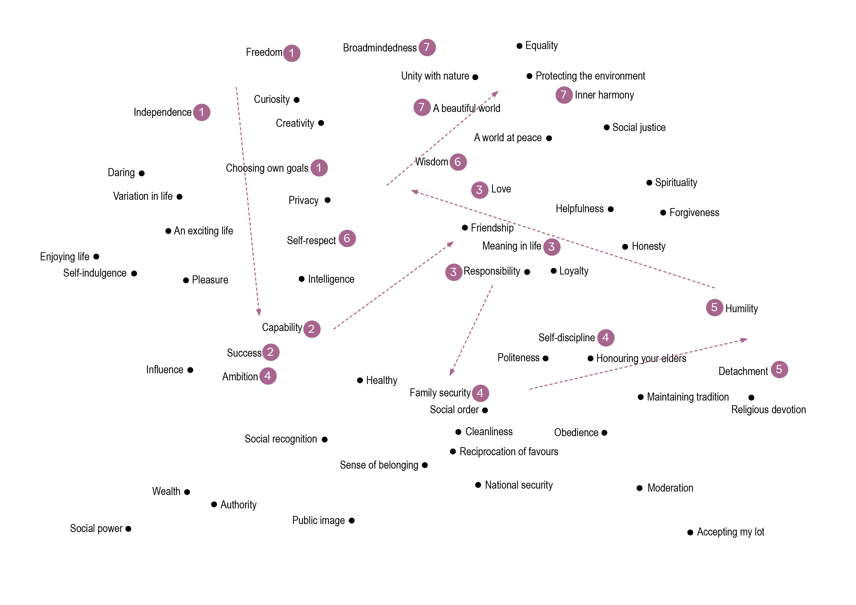
Migration Rhythms – SLIDE 14
Example Values Journey

Slide 15
Migration Rhythms – SLIDE 15
Different forms of movement
External – outside of a country or region to a different country or region.
Internal – within a country, region, city or town.
Temporary – for a limited period.
Permanent – involves relocation to a new place.
Regular –involves a regular and repeated pattern like commuting or seasonal.
Irregular – not part of a pattern and may be a one-off movement.
Voluntary – a choice of the individual/group involved.
Forced – where people have had to move to avoid danger or risk for example.

Slide 16
Migration Rhythms – SLIDE 16
Social mobility refers to the movement of individuals or groups within a society's social hierarchy. It essentially describes the extent to which someone's social status, often measured by income, occupation, or education, is linked to their parents' social status.
(Google AI Overview definition)
Social mobility is the movement of individuals, families, households or other categories of people within or between social strata in a society. It is a change in social status relative to one's current social location within a given society. The movement can be in a downward or upward direction.
(Wikipedia definition)
Defining social mobility

Slide 17
Migration Rhythms – SLIDE 17
Tita Nurse moves to Germany (spatial mobility) to improve the lives of her family members in Manila (social mobility).
‘Treasures’ sent home (spatial) in Balikbayan Boxes provide family members with the trappings (features and benefits) of middle-classness (social).
Thanks to support from Tita Nurse in the form of laptop and other study resources sent to him from Germany (spatial) the main character is able to get a good education and qualify as a doctor (social).
Being a doctor (social), they are able to command a good job overseas (spatial) and provide ongoing support to their family (social).

Slide 18
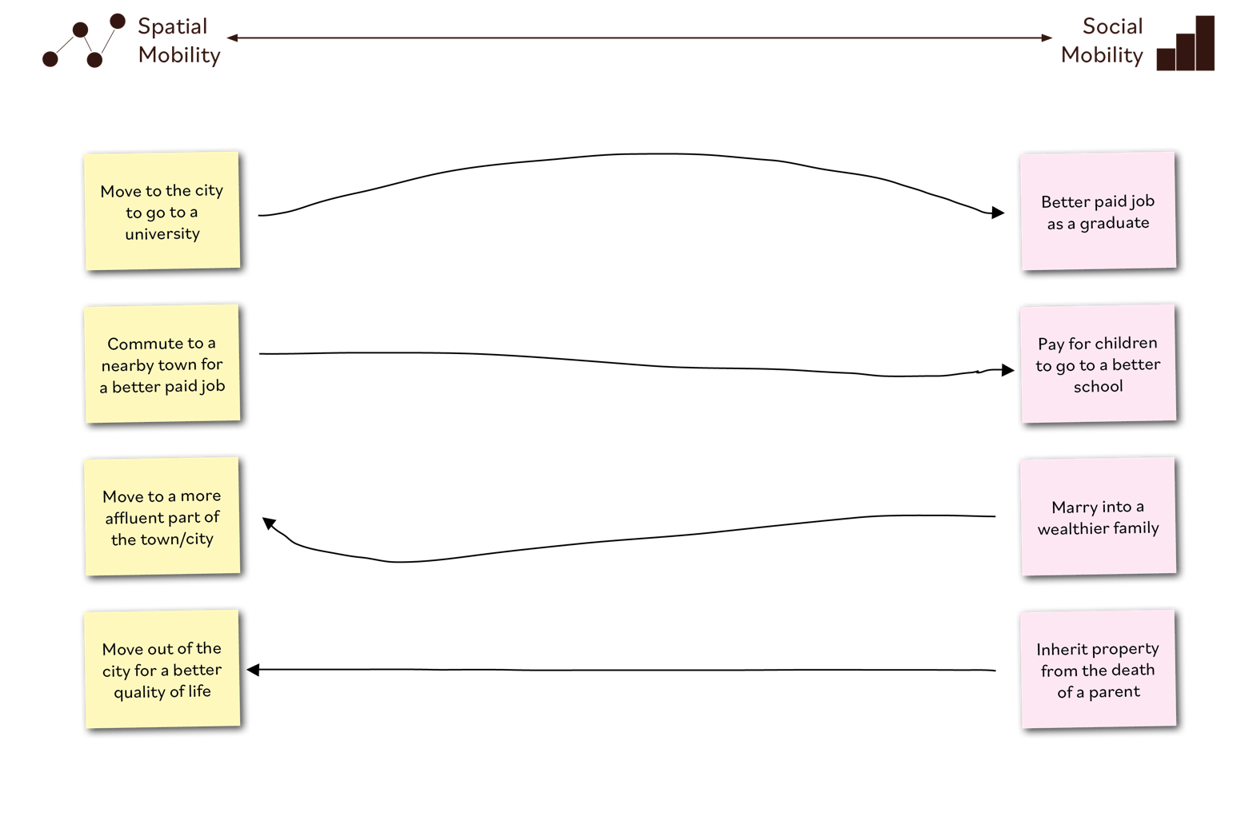
Migration Rhythms – SLIDE 18
Examples linking spatial & social mobility

Slide 19
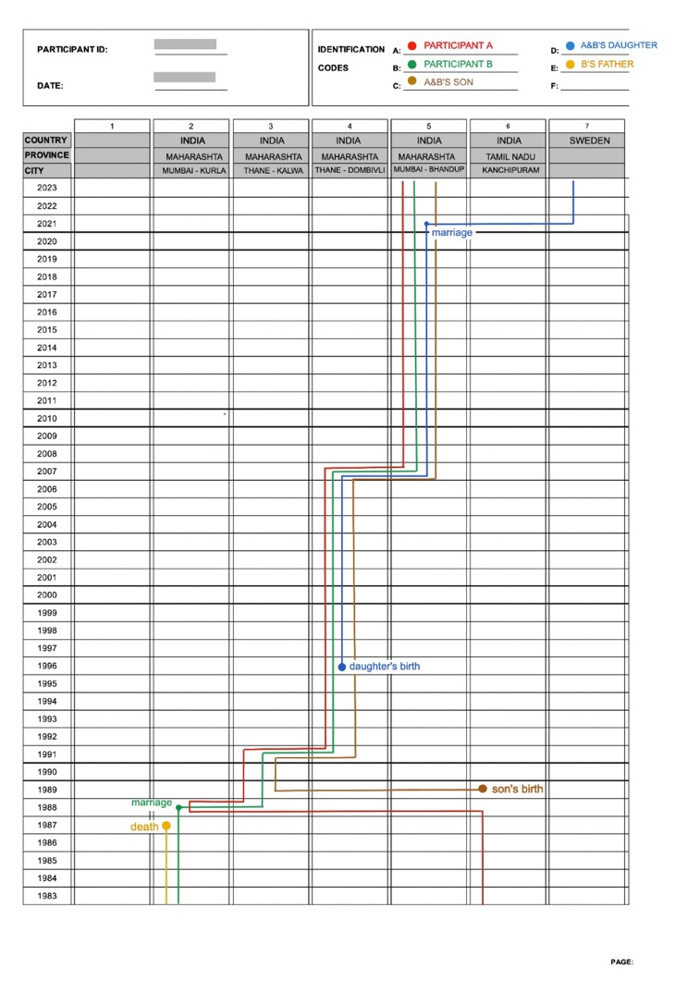
Migration Rhythms – SLIDE 19
Example of a Migration Rhythm Map from the research project.

Slide 20
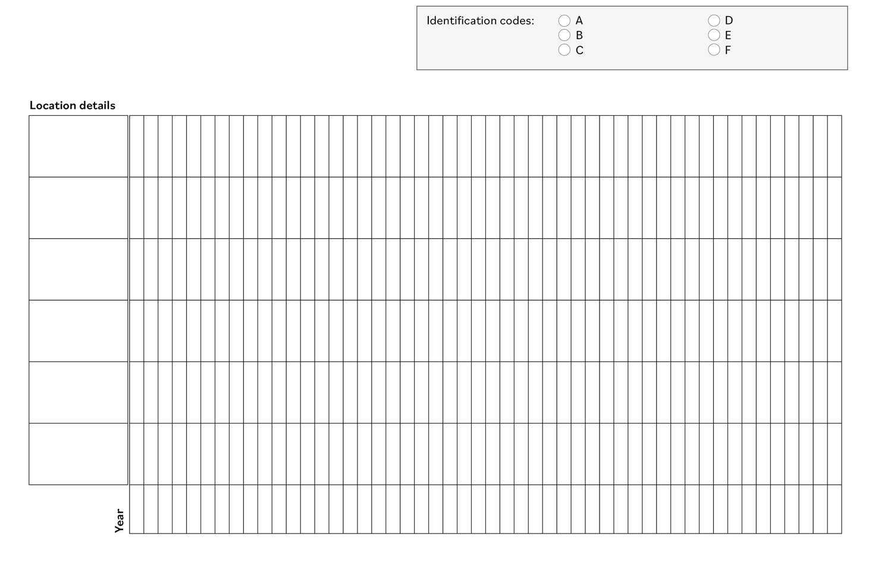
Migration Rhythms – SLIDE 20
Template for Migration Rhythm Map

Slide 21
Migration Rhythms – SLIDE 21
Sustainable Development: Development that meets the needs of the present without compromising the ability of future generations to meet their own needs.
World Commission on Environment and Development (WCED) report, Our Common Future (1987)

Slide 22
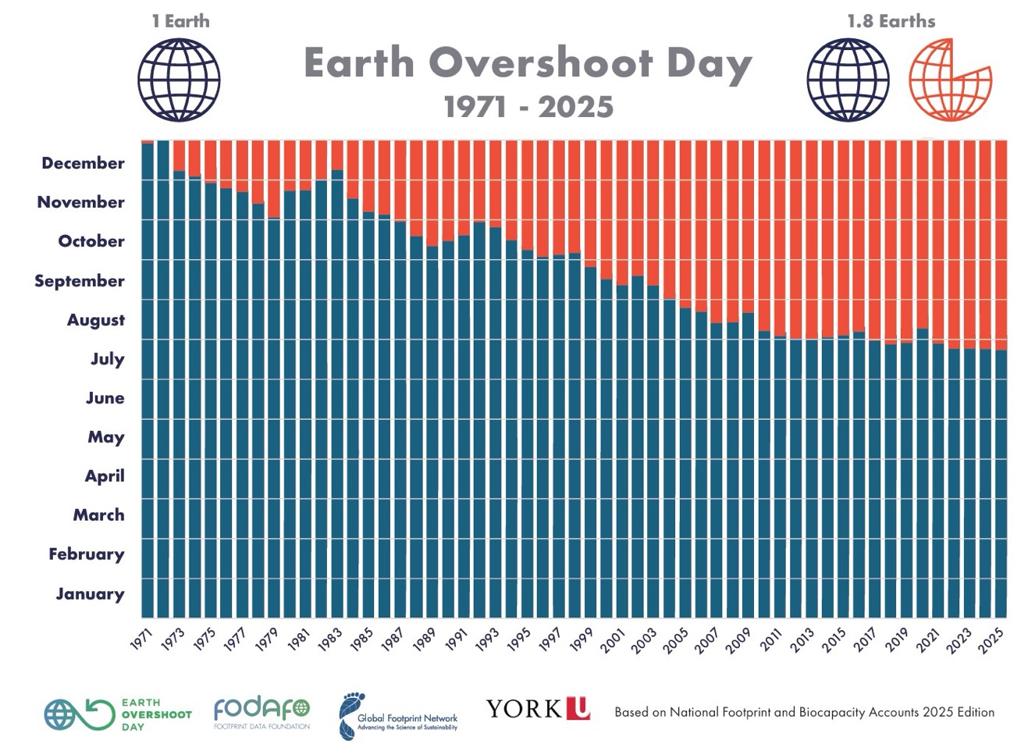
Migration Rhythms – SLIDE 22
Earth Overshoot Day marks the date when humanity’s demand for ecological resources and services exceeds what Earth can regenerate in that year.
2025 = 24th July

Slide 23
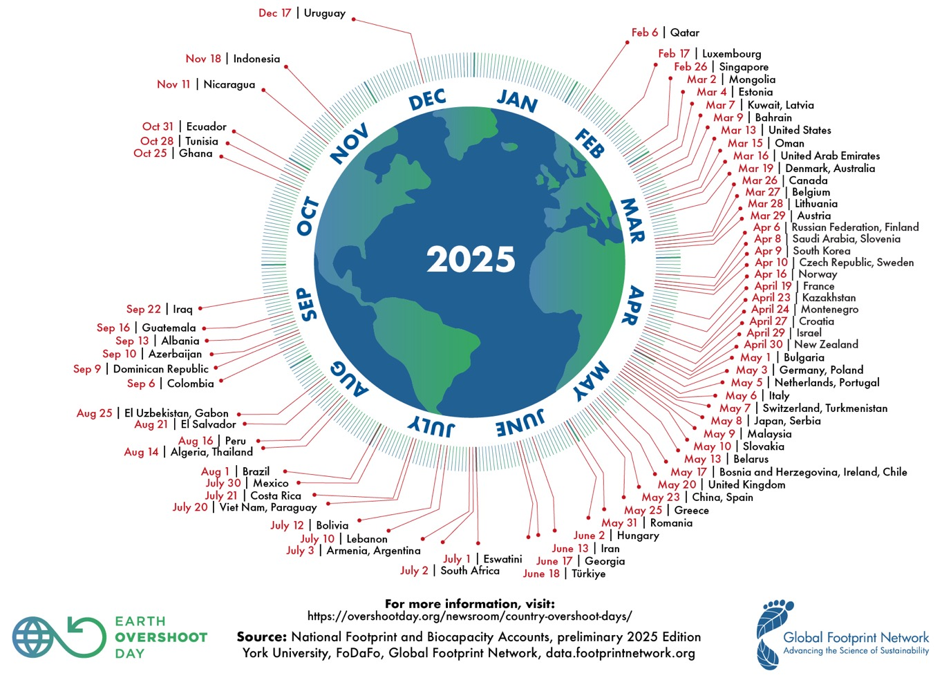
Migration Rhythms – SLIDE 23
Country Overshoot Days 2025
When Earth Overshoot Day would be if all the people in the world lived like those in …

Slide 24
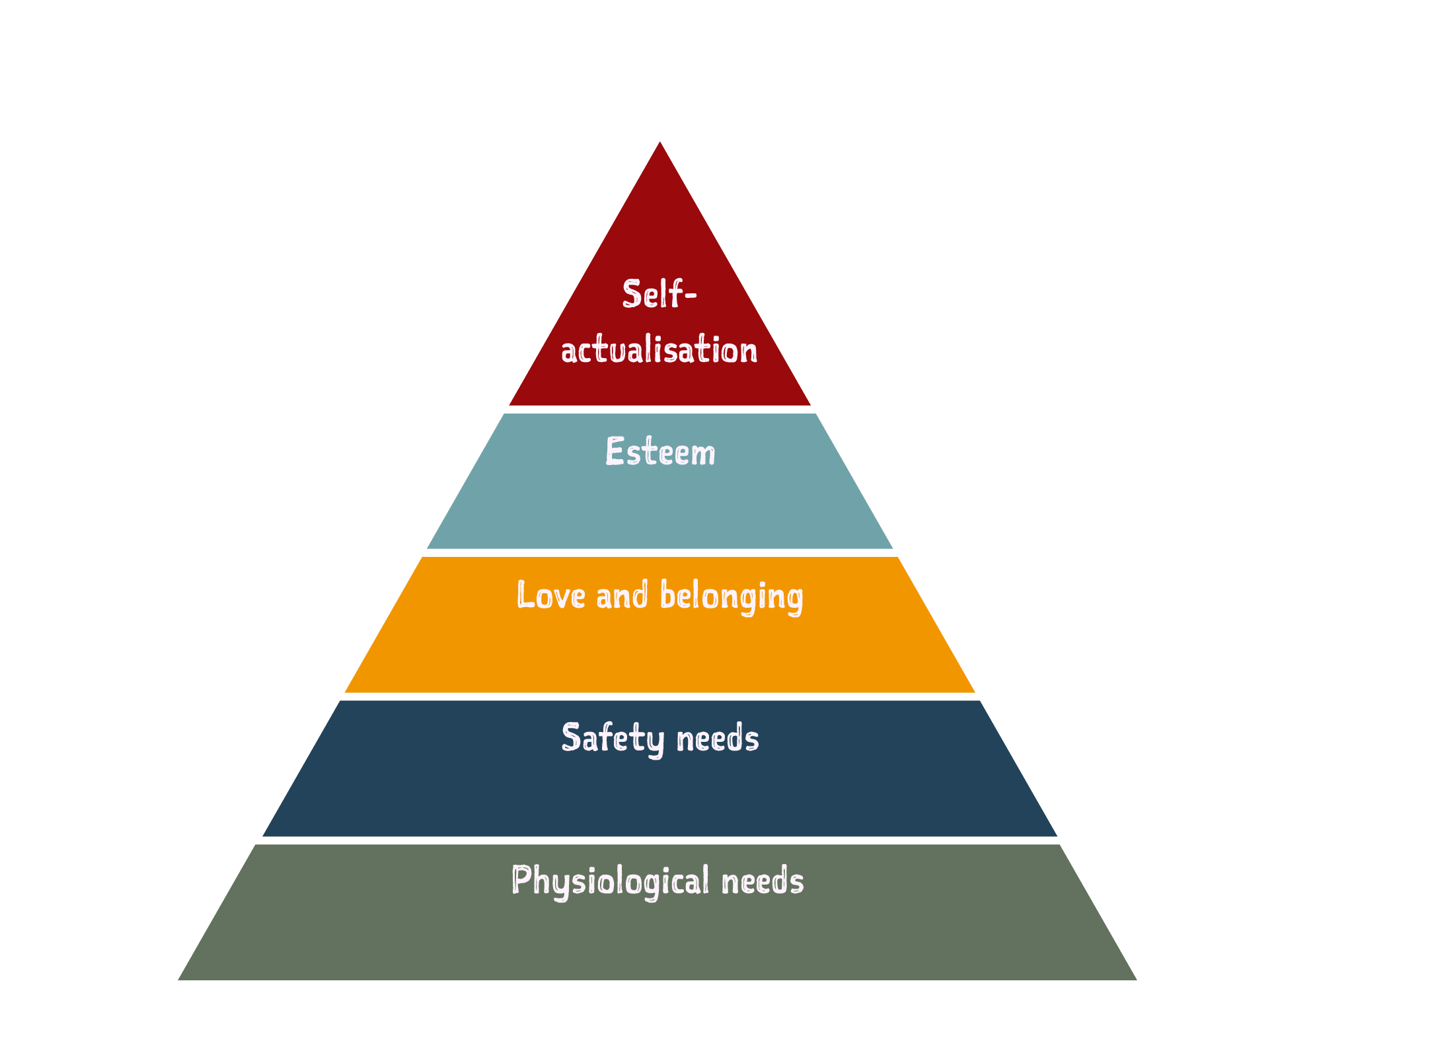
Migration Rhythms – SLIDE 24
Maslow’s hierarchy of needs
Maslow suggests that humans have 5 levels of need.
These are arranged in a hierarchy from physiological (survival) needs at the bottom through to self-actualisation (achieving your full potential) at the top.
Maslow states that you can only proceed up the hierarchy if your needs at the lower levels have been met.

Slide 25
Migration Rhythms – SLIDE 25
I am Mumbai, city of …

Slide 26
Migration Rhythms – SLIDE 26
Remittances: when migrants send home part of their earnings in the form of either cash or goods to support their families, these transfers are known as workers’ or migrant remittances.
(International Monetary Fund, IMF)
Remittances: transfers of money from residents of one country to residents of another country and are often associated with migrants sending money to families and their communities.
(The Migrant Observatory, University of Oxford)

Slide 27
Migration Rhythms – SLIDE 27
Resilience: The process and outcome of successfully adapting to difficult or challenging life experiences, especially through mental, emotional, and behavioral flexibility and adjustment to external and internal demands.
A number of factors contribute to how well people adapt to adversities, predominant among them:
the ways in which individuals view and engage with the world,
the availability and quality of social resources, and
specific coping strategies.
Source: American Psychological Association (https://www.apa.org/topics/resilience)

Slide 28
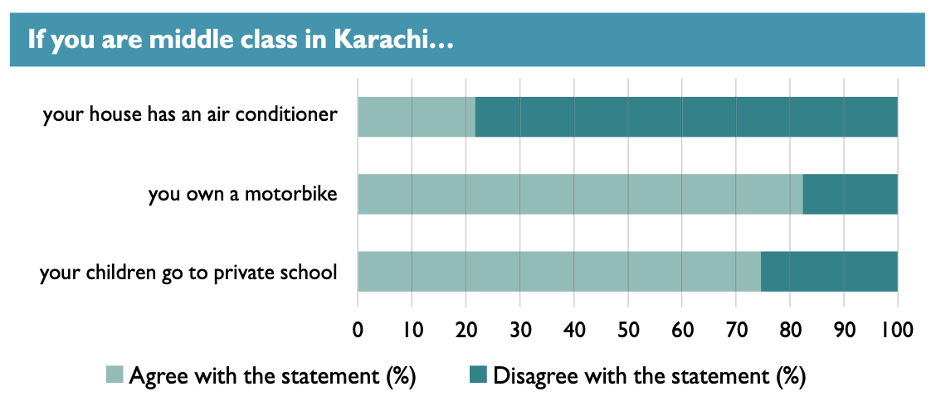
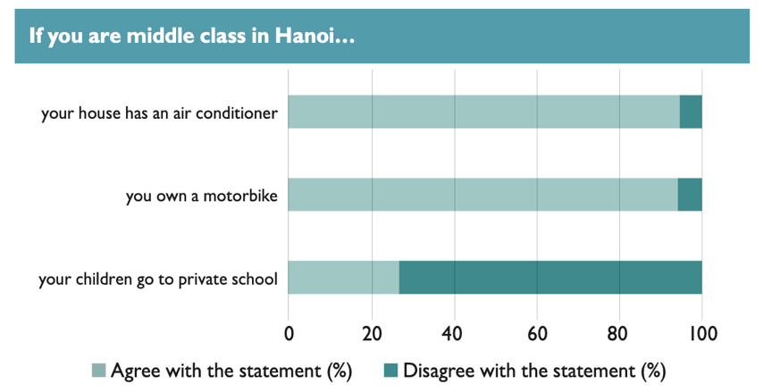
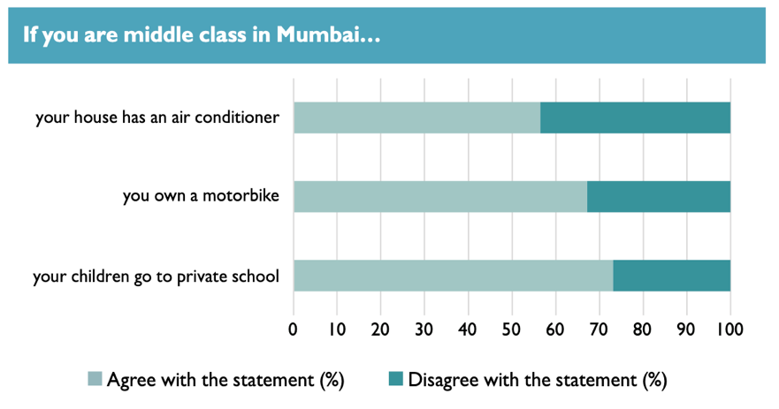
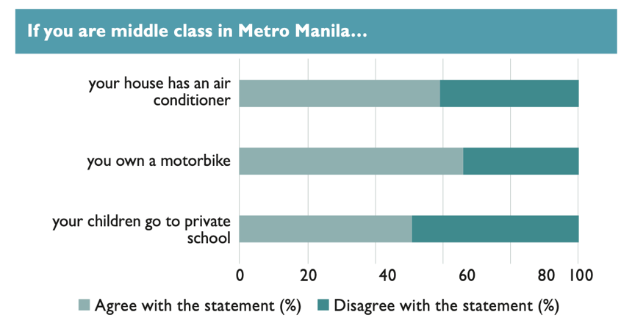
Migration Rhythms – SLIDE 28
Source: Migration Rhythms survey (2023)

Slide 29
Migration Rhythms – SLIDE 29

Slide 30
Migration Rhythms – SLIDE 30

Slide 31
Migration Rhythms – SLIDE 31

Slide 32
Migration Rhythms – SLIDE 32

Slide 33
Migration Rhythms – SLIDE 33

Slide 34
Migration Rhythms – SLIDE 34

Slide 35
Migration Rhythms – SLIDE 35

Slide 36
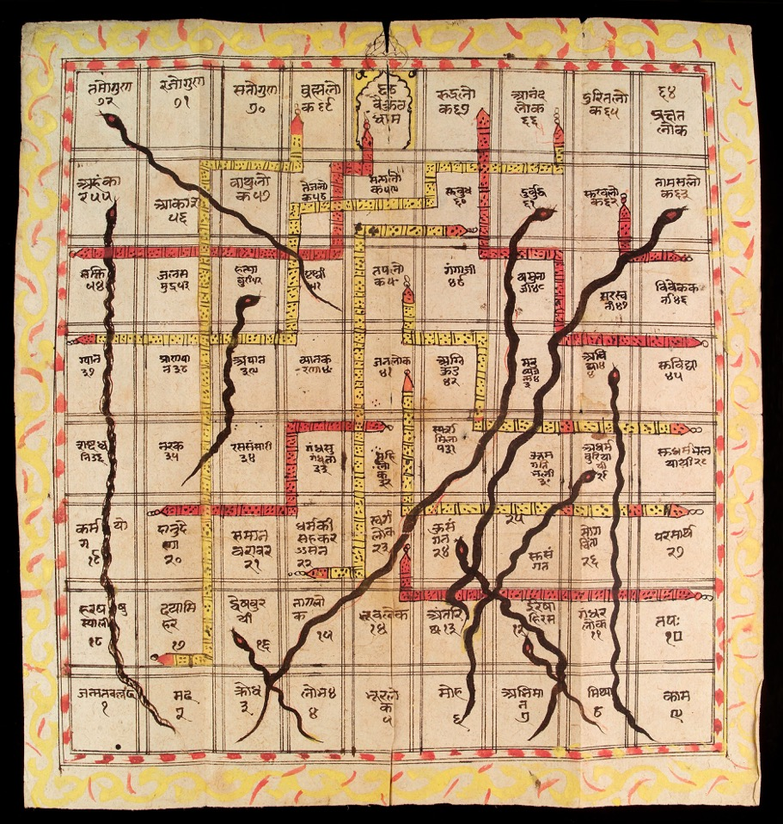
Migration Rhythms – SLIDE 36
Moksha Patamu (snakes and ladders)
A game originating in India.
Originally about achieving more high standing (also known as the heaven and hell game).
Ladders for good (virtuous) acts.
Snakes for bad (vice) acts.
Image: Creative Commons 4.0 from Wellcome collection -wellcomecollection.org/works/geydgvms

Slide 37

Migration Rhythms – SLIDE 37
The Migration Rhythms project has received funding from the European Research Council (ERC) under the Horizon 2020 research and innovation programme
(Grant agreement No. 94840) (2021-2026)

